Slide 1
UAV Ground Detection
Distinguish Tree Species
Christian Ekeigwe, Daehyeon Jeong, Jaeyeong Shim, Jeonghwan Kang, Seoungheong Jeong
Project 17

Slide 2
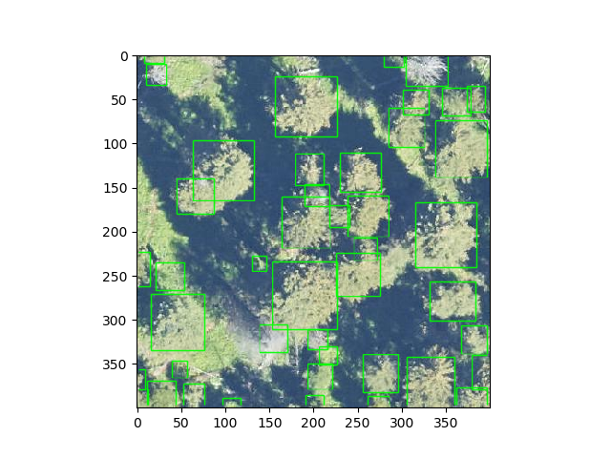
Detecting Tree model
Deep Forest
Training and predicting individual tree airborne RGB image
https://deepforest.readthedocs.io/en/latest/landing.html

Slide 3
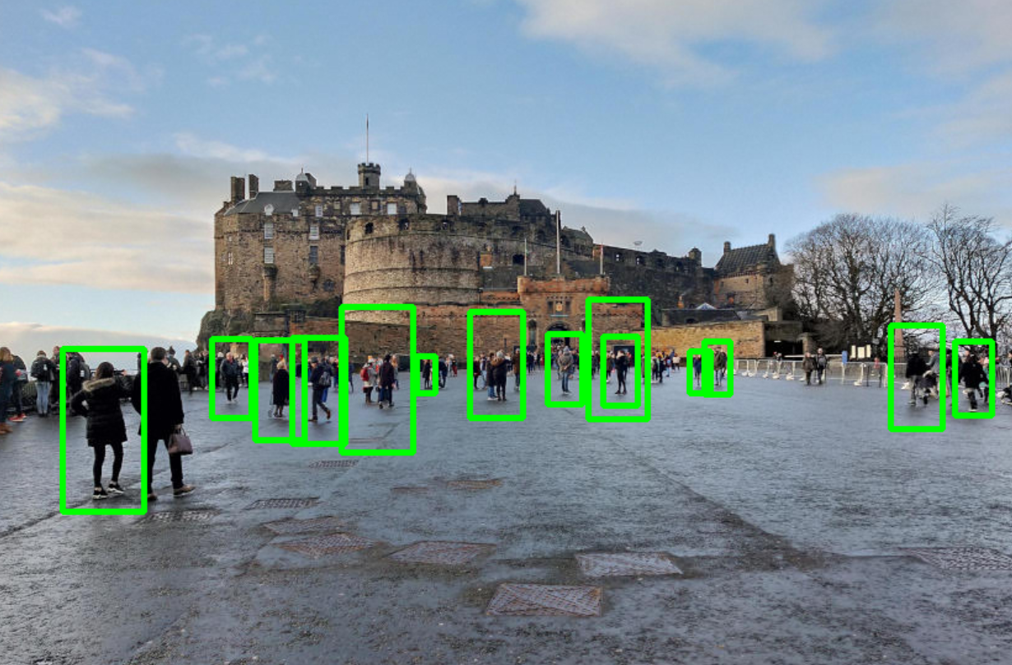
Detect Objects in Real Time
Using OpenCV and Python
When using UAV ground detecting we need to use real time object detection
OpenCV?
library of programming functions mainly aimed at real-time computer vision.

Slide 4
Detect Objects in Real Time
Using OpenCV and Python
When using UAV ground detecting we need to use real time object detection
OpenCV?
library of programming functions mainly aimed at real-time computer vision.

Slide 5
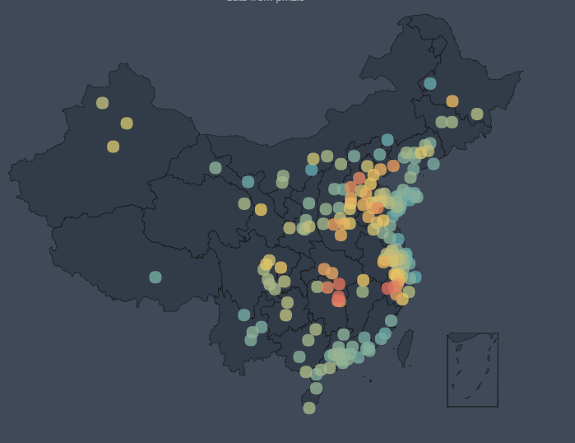
Tree data with GPS
We need to use tree data with GPS
Then we can make GEO charts.
Maybe we can use some libraries like pyecharts.
But, how to get this data?

Slide 6
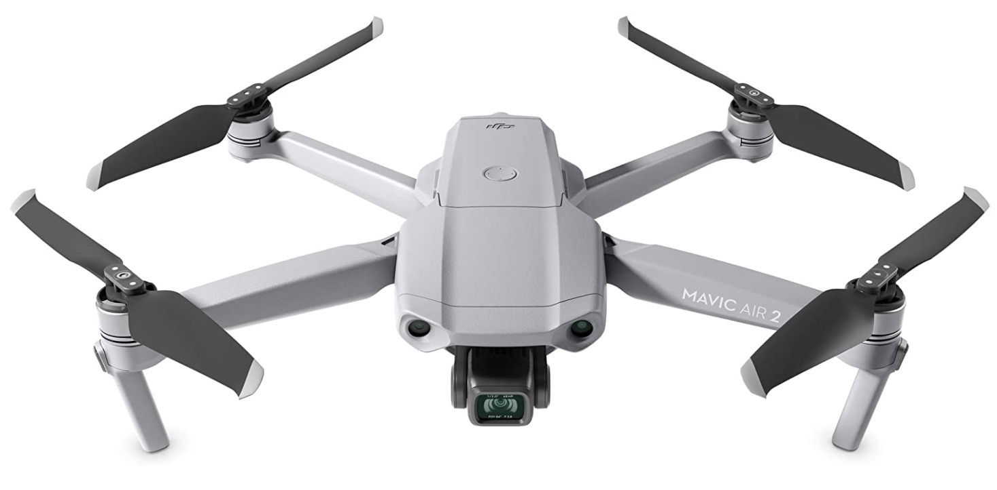
Collecting data using UAV
Collecting data using UAV
But we think it is hard to use UAV in Korea forest and gathering data.
So, we try to find some new method.
Finally, we find a solution

Slide 7
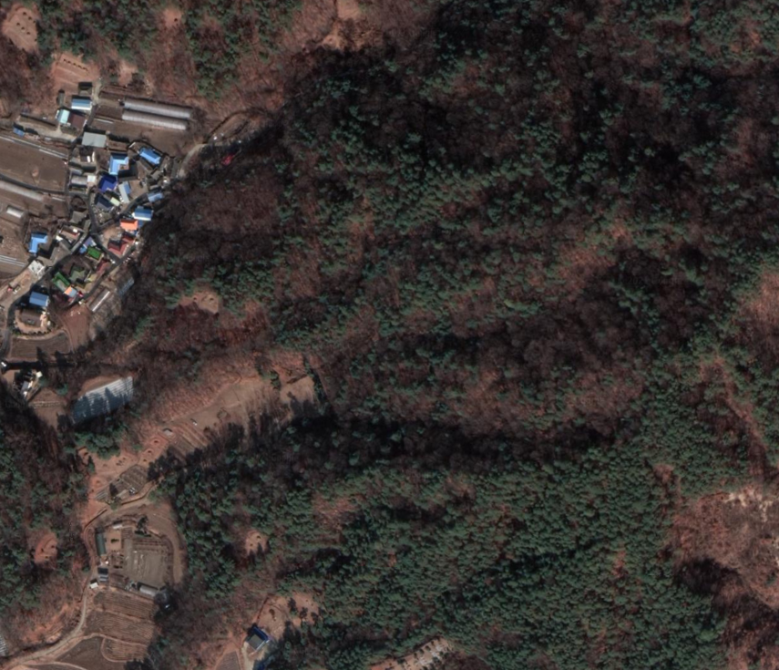
Google map trick
We’ll use google map api
We can get satellite picture of forest.
It contains RGB and GPS data.
Then now, we have modeling data.

Slide 8
Plan
Step 1
Get data from gMap
Make modeling system
Classify data
(Distinguish Tree Species)
Modeling data
Step 2
Real time receive data from UAV
Add/Del data from GEO chart
Step 3

Slide 9
Thank you
Questions?

